Slide 1


Single Cell Perturbation Analysis With Geneformer
© ThinkBio.Ai All Right Reserved

Slide 2

Agenda
Gene Embeddings and Insilico Perturbation
Insilico Perturbation and VCC
VCC with Geneformer's ISP
Results

Slide 3
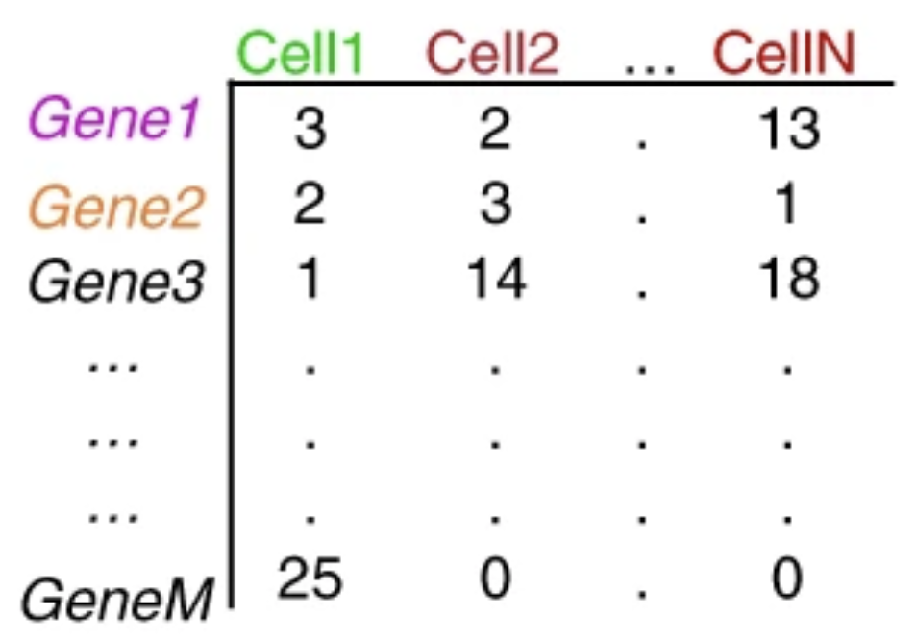
Gene Embeddings
Geneformer the foundation model
Rank value encodings
HVGs
What are gene embeddings
KEYS
GENEFORMER Encoder
TP53
EGFR
BRCA1
MYC
KRAS
CDK1
…
BCL2
PTEN
ATM
MAPK1
4096 HVGs
Cell X Gene matrix
TP53:
[ 0.12, -0.45, 1.03, ..., -0.18, 0.77 ] ← 768 dim
EGFR:
[-0.34, 0.91, 0.22, ..., 1.02, -0.44 ]
BRCA1
[ 0.88, 0.14, -0.67, ..., -0.09, 0.51 ]
Tokenizer
Rank value Encodings
Cell Embedding
[-0.34, 0.91, 0.22, ..., -0.89, 1.14 ] - 768 dim

Slide 4
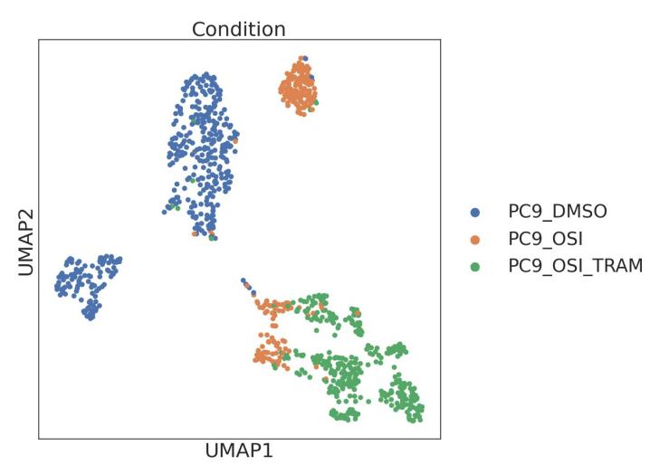
Insilico Perturbation in Geneformer
PC9 DMSO
GENEFORMER Encoder
PC9 OSI
PC9 OSI-TRAM

Slide 5

1 Genes at a time
GENEFORMER Encoder
PC9 DMSO
TP53
EGFR
BRCA1
MYC
KRAS
CDK1
…
BCL2
PTEN
ATM
MAPK1
4096 HVGs
Tokenizer
{"delete", "overexpress", "inhibit", "activate"},

Slide 6
2 Genes at a time
GENEFORMER Encoder
PC9 DMSO
TP53
EGFR
BRCA1
MYC
KRAS
CDK1
…
BCL2
PTEN
ATM
MAPK1
4096 HVGs
Tokenizer
{"delete", "overexpress", "inhibit", "activate"},

Slide 7



VCC AND PERTURBATION
Perturbed gene | No of cells
g1 | 4000
g2 | 3800
g3 | 3750
g150 | 15
TRAINING SET
CONTROL CELLS
38 K CELLS
PERTURBED CELLS
Ground Truth
TRAINING
VALIDATION SET
Perturbed gene | No of cells
g1 | 4000
g2 | 3800
g3 | 3750
g50 | 15
VIRTUAL CELLS
PREDICT

Slide 8
TEST SET
Perturbed gene | No of cells
g1 | 4000
g2 | 3800
g3 | 3750
g100 | 15
VIRTUAL CELLS
CONTROL CELLS
38 K CELLS
PREDICT

Slide 9
Challenge of using Genformer in VCC
GENEFORMER Encoder
GENEFORMER
Decoder
TP53
EGFR
BRCA1
MYC
KRAS
CDK1
…
BCL2
PTEN
ATM
MAPK1
TP53
EGFR
BRCA1
MYC
KRAS
CDK1
…
BCL2
PTEN
ATM
MAPK1
18080 genes per cell
4096 genes per cell
4096 genes per cell
Cell X Gene
Rank value Encodings
Rank value Encodings

Slide 10
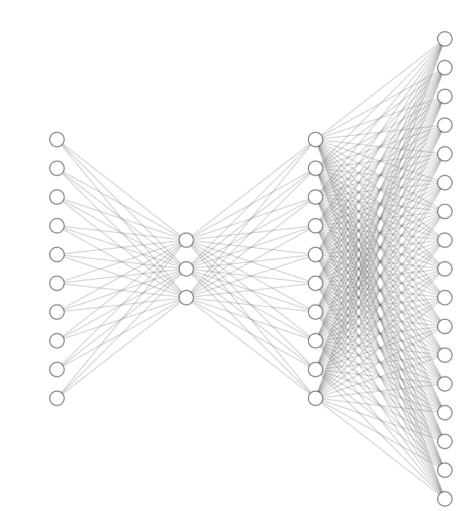
BLUE PRINT
GENEFORMER Encoder
TP53
EGFR
BRCA1
MYC
KRAS
CDK1
…
BCL2
PTEN
ATM
MAPK1
4096
18080
18080 genes per cell
4096 genes per cell
18080 genes per cell
Cell X Gene
Rank value Encodings
Cell X Gene

Slide 11
Model output
Model Input
EGFR : [ 90 ]
TP53 : [ 45 ]
MAP2K1 : [ 120 ]
..
..
..
..
..
..
BRCA1 : [ 25 ]
..
..
..
..
..
.
MYC : [ 300 ]
EGFR :
[ 0.001, 0.003, 0.760, -0.214, 0.089, 0.442, -0.031, 0.118, ... , 0.001 ]
TP53 :
[ -0.342, 0.517, 0.104, -0.889, 0.276, 0.061, 0.438, -0.092, ... , -0.215 ]
MAP2K1 :
[ 0.224, -0.117, 0.059, 0.341, -0.402, 0.611, 0.094, -0.178, ... , 0.307 ]
..
..
..
..
..
..
..
..
MYC :
[ 0.451, 0.028, -0.316, 0.902, -0.144, 0.073, -0.291, 0.198, ... , 0.556 ]
4096
18080

Slide 12
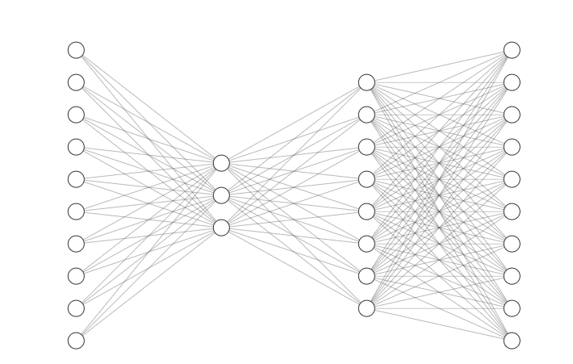
Model output
Model Input
EGFR :
[ 0.001, 0.003, 0.760, -0.214, 0.089, 0.442, -0.031, 0.118, ... , 0.001 ]
TP53 :
[ -0.342, 0.517, 0.104, -0.889, 0.276, 0.061, 0.438, -0.092, ... , -0.215 ]
MAP2K1 :
[ 0.224, -0.117, 0.059, 0.341, -0.402, 0.611, 0.094, -0.178, ... , 0.307 ]
..
..
..
MYC :
[ 0.451, 0.028, -0.316, 0.902, -0.144, 0.073, -0.291, 0.198, ... , 0.556 ]
EGFR : [ 90 ]
TP53 : [ 45 ]
MAP2K1 : [ 120 ]
..
..
..
..
BRCA1 : [ 25 ]
..
..
.
MYC : [ 300 ]
18080
18080

Slide 13



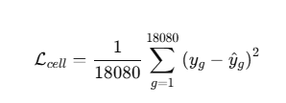

VirtualCell Generator Architecture
Step 1: Raw gene counts were log-normalized
Step 2: Model prediction
Step 3: Gene-wise squared error
Step 4: Average across genes
Cell Vector (18,080)
Dense + LN + GELU (8192)
Dense + LN + GELU (4096)
Dense + LN + GELU (2048)
Dense + LN + GELU (4096)
Step 5: Average across batch
Dense + LN + GELU (8192)
Cell Vector (18,080)

Slide 14
Results

Slide 15

Thank You
3020 Old Ranch Pkwy.
Suite 300, Seal Beach, CA 90740
3602 Inland Empire Blvd., Suite C200,
Ontario, CA 91764, United States
611 Gateway Blvd, Suite 120,
South San Francisco, CA 94080
Info Park Phase-II,
Kakkanad, Kochi, India
Yamuna, Technopark Phase III
Trivandrum, India
34-35 Hatton Garden, Holborn,
London EC1N 8DX
contactus@thinkbio.ai
+1- 909-303-3338

